Slide 1
Credit Card Intelligence
Leveraging customer financial data for business growth
Group 3 - Grandmasters
Garcia | Legaspi | Mamangun | Reguyal | Tolentino
Notes:
Credit Card Intelligence
Leveraging customer financial data for business growth

Slide 2
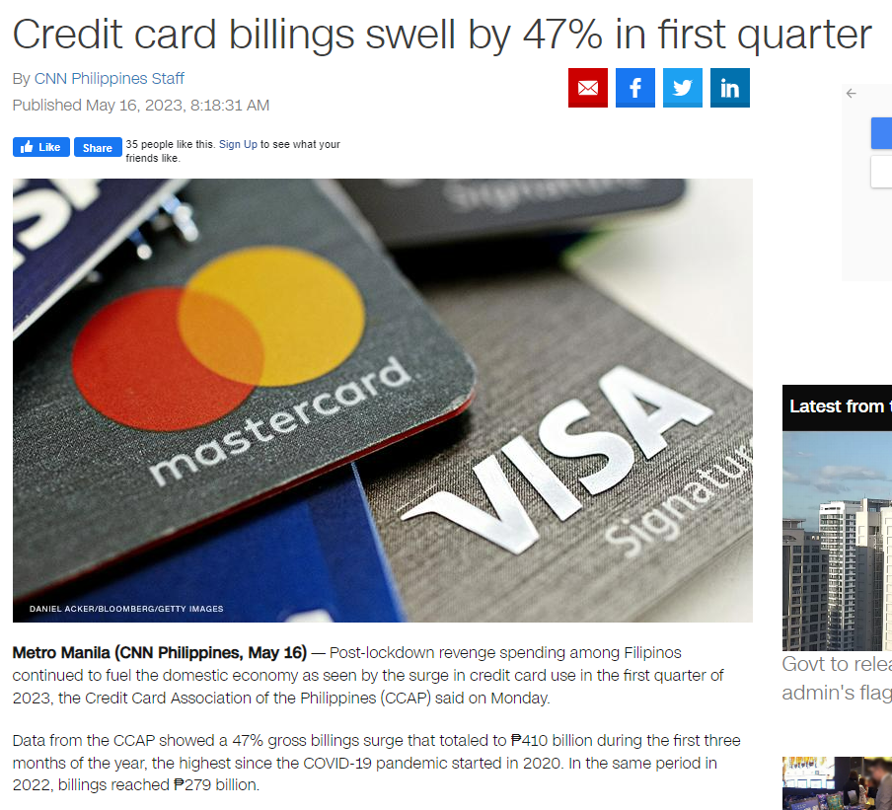
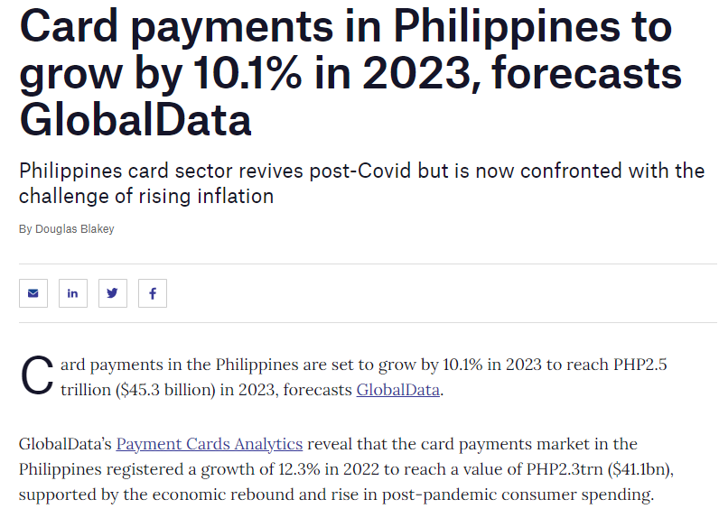
Credit Card popularity on the rise in the Philippines
Notes:
For context, what are recent news in the credit card space here in our country?
According to the Credit Card Association of the Philippines, there has been a 47 percent increase in gross credit card billings in the Philippines from the first quarter of 2022 to the same period in 2023.
Global Data, a London-based data analytics company, forecasted a 10.1 percent increase in card payments in 2023

Slide 3
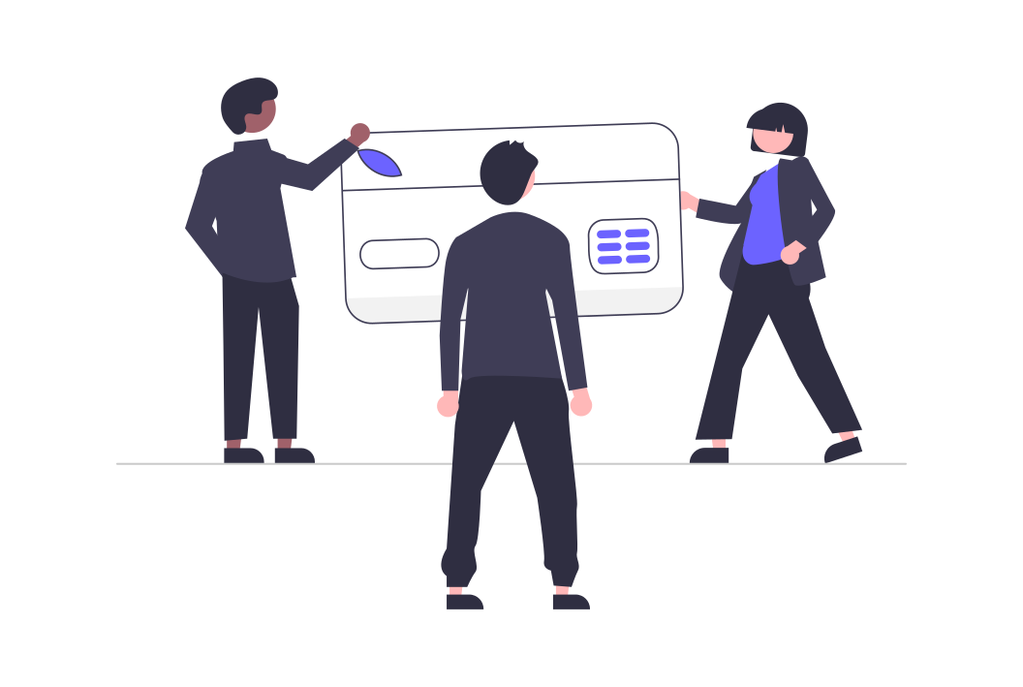

Who are we?
A team of data enthusiasts specializing in customer financial data. Our group devised a business-ready, easy-to-absorb analysis for credit card companies.
We aim to use this tool to leverage their data into profitable, action-oriented analysis.
Notes:
Our group devised a basic, easy-to-absorb analysis for credit card companies to leverage their data into profitable, action-oriented insights.

Slide 4
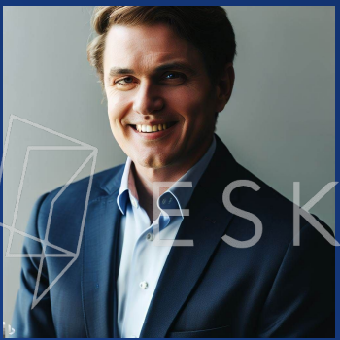
Adobo Advantage Cards seeks our help to make better data-driven decisions
They want to:
Take advantage of credit card fever
Understand customer behavior and spending patterns
Uncover customer segments and discover untapped opportunities
John Johnson
AAC CEO
Notes:
Our client Adobo Advantage Cards provided us their data and tasked us to understand customer behavior patterns and discover untapped opportunities so they can take advantage of the credit card fever

Slide 5


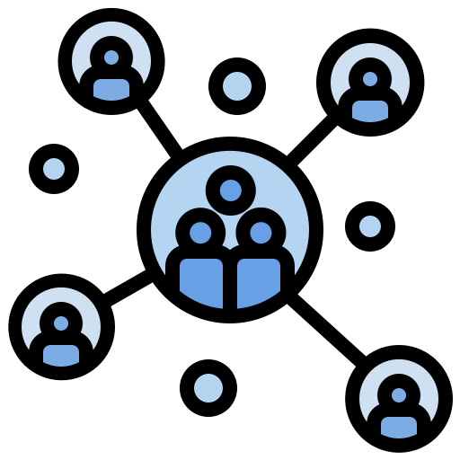

Methodology
Data Cleaning and Preprocessing
Exploratory Data Analysis
RFM Segmentation and Clustering
Interpretation of Results
100K Transactions
Data Used:
89 Customers
Notes:
> Data Cleaning: Enhance the quality of the dataset by removing redundancies, standardizing data formats, handling missing values, and ensuring that columns are of the appropriate data types. These steps contribute to a cleaner, more consistent, and more analytically useful dataset.
> Data Preprocessing (Feature Engineering): Improve the model's ability to capture patterns and relationships. Create new features to extract meaningful information from the data.

Slide 6
Exploring the Dataset

Slide 7
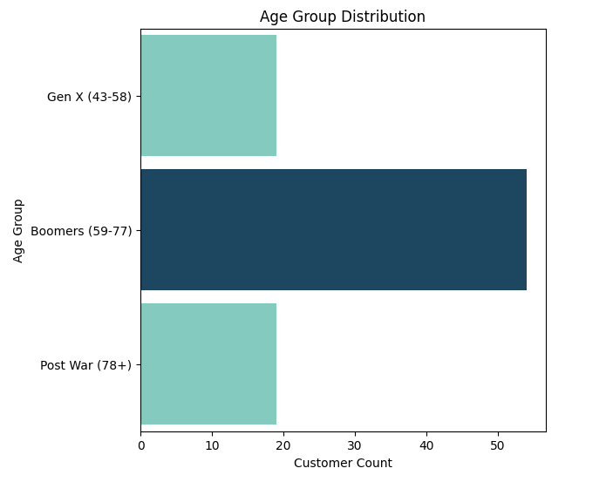
What is the Age Distribution of our customers?
54
All the customers are above the age of 50
Boomers (Ages 59 - 77) are 61% of the customers

Slide 8
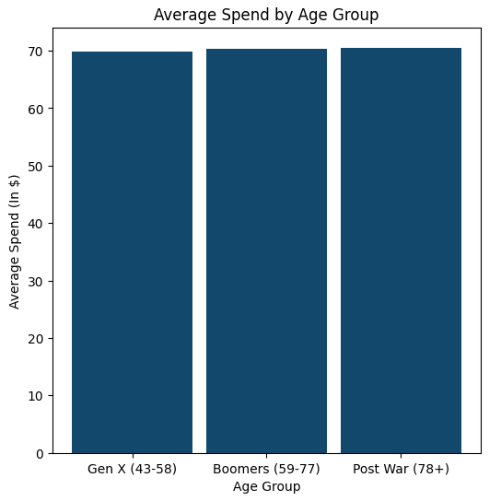
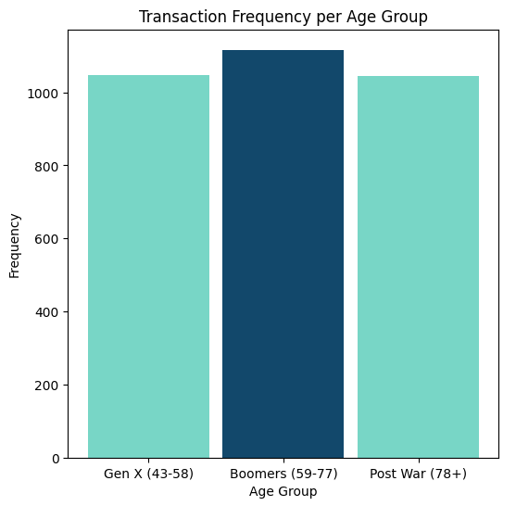
What is the Average Spend and Frequency of each generation?
70
1.1K
Each generation has roughly the same average spend and transaction frequency
Notes:
Income ng Boomers relatively higher

Slide 9
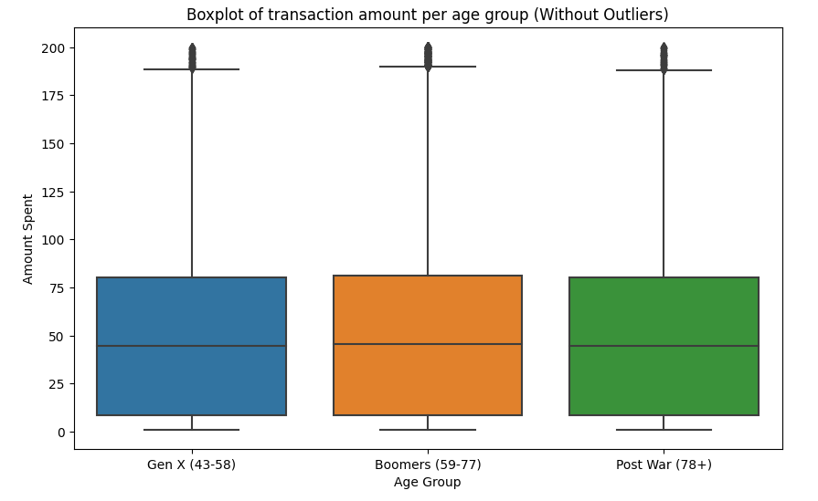
What is the Spending Range of our Customers?
Each generation has roughly the same amount spent on most transactions
(~ $20 - $75)
Good opportunity to increase the spend per transaction for each generation.

Slide 10
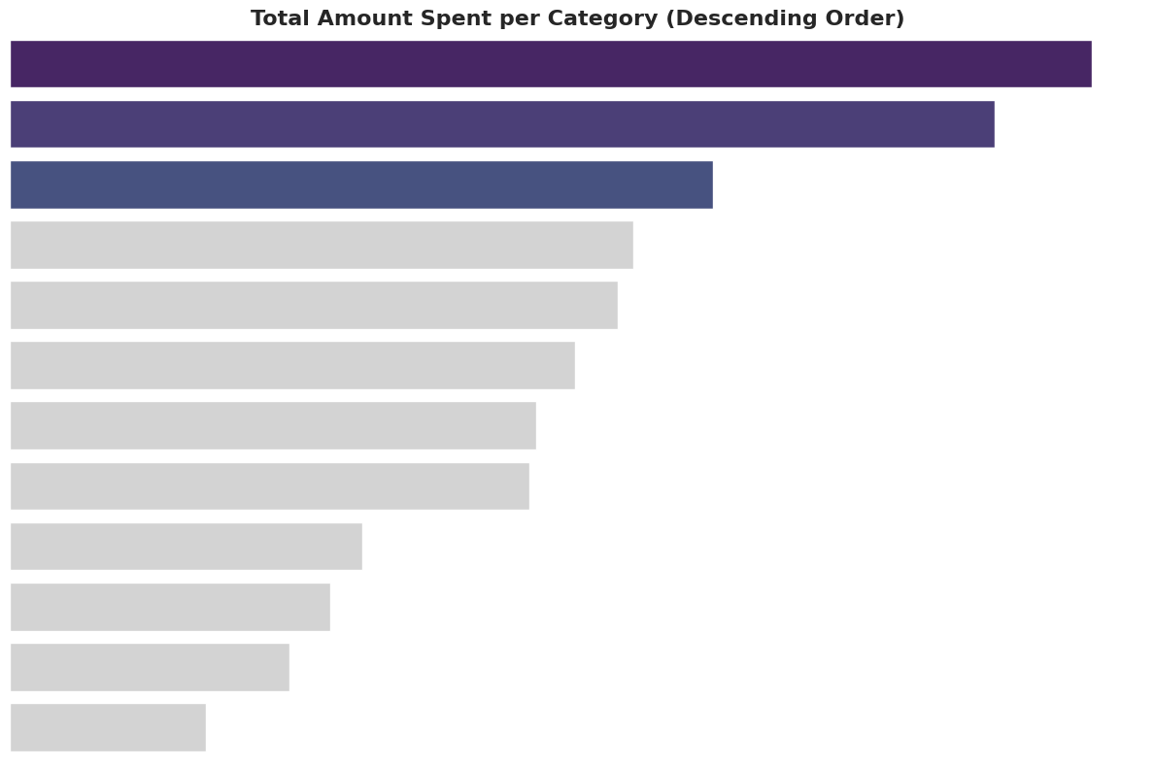
What is the Total Amount Spent per Category?
shopping
grocery
kids_pets
gas_transport
misc
food_dining
home
The highest amount spent is on the shopping category.
N/A
entertainment
personal_care
travel
health_fitness
Notes:
We also took a look at the total amount spent per category, and we found shopping, grocery and kids/pets related purchases to be the priority among AAC’s customer base.

Slide 11
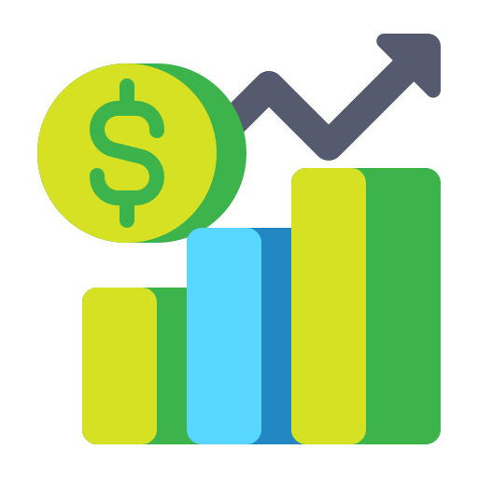
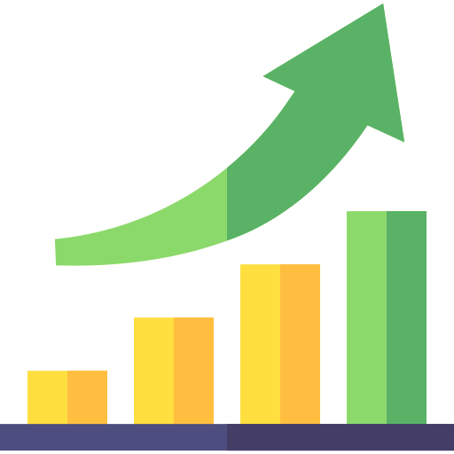
Main Objectives
Increase Amount Spent per Transaction
Increase Number of Transactions
Notes:
Priming our objectives, we focused on a major source of income for credit card companies, which are fees collected as a percentage of the transaction amount, aka processing fees. So keeping this in mind, our objectives for the growth of AAC is to encourage its customer-base to (1) spend more and (2) increase the frequency of their credit card usage

Slide 12
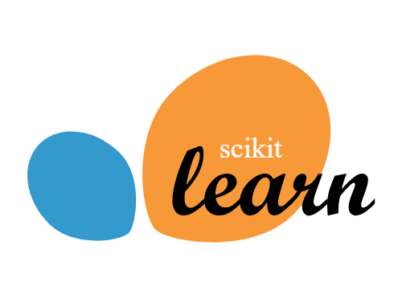

There are two data science-powered approaches to reach these objectives
RFM Segmentation
K-Means Clustering
Notes:
So we took 2 Data Science approach to accomplish these objectives.
First of which is, RFM Segmentation which we did to better understand customer behavior and spending patterns. With this, strategic recommendations tailor-fit to each customer-segments is made possible.
And second, we did KMeans Clustering based on transactions to have an idea which categories customers spend their money on.

Slide 13
RFM Segmentation
Segmentation | Definition
Champions | Customers who have bought the most recent, the most often, and spent the most.
Loyal Customers | Customers who buy the most often
Big Spenders | Highest paying customers
Infrequent Buyers | Customers who don’t buy often
New Customers | First time buyers
Average Customers | Customers who have average spending, and buys regularly
Hibernation | Customers who bought the least amount, least often, and have not bought for a long time

Slide 14
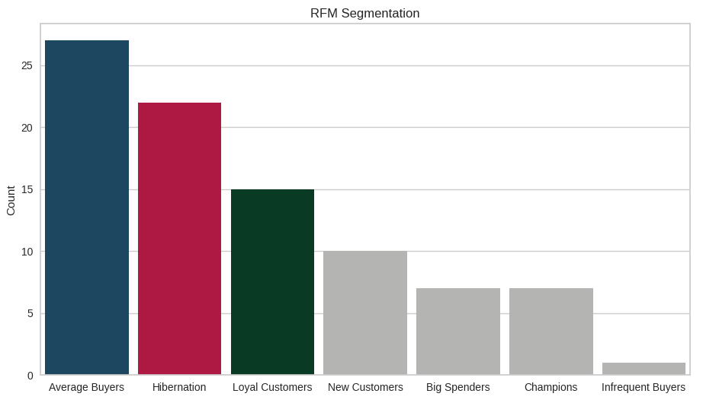
RFM Segmentation

Slide 15
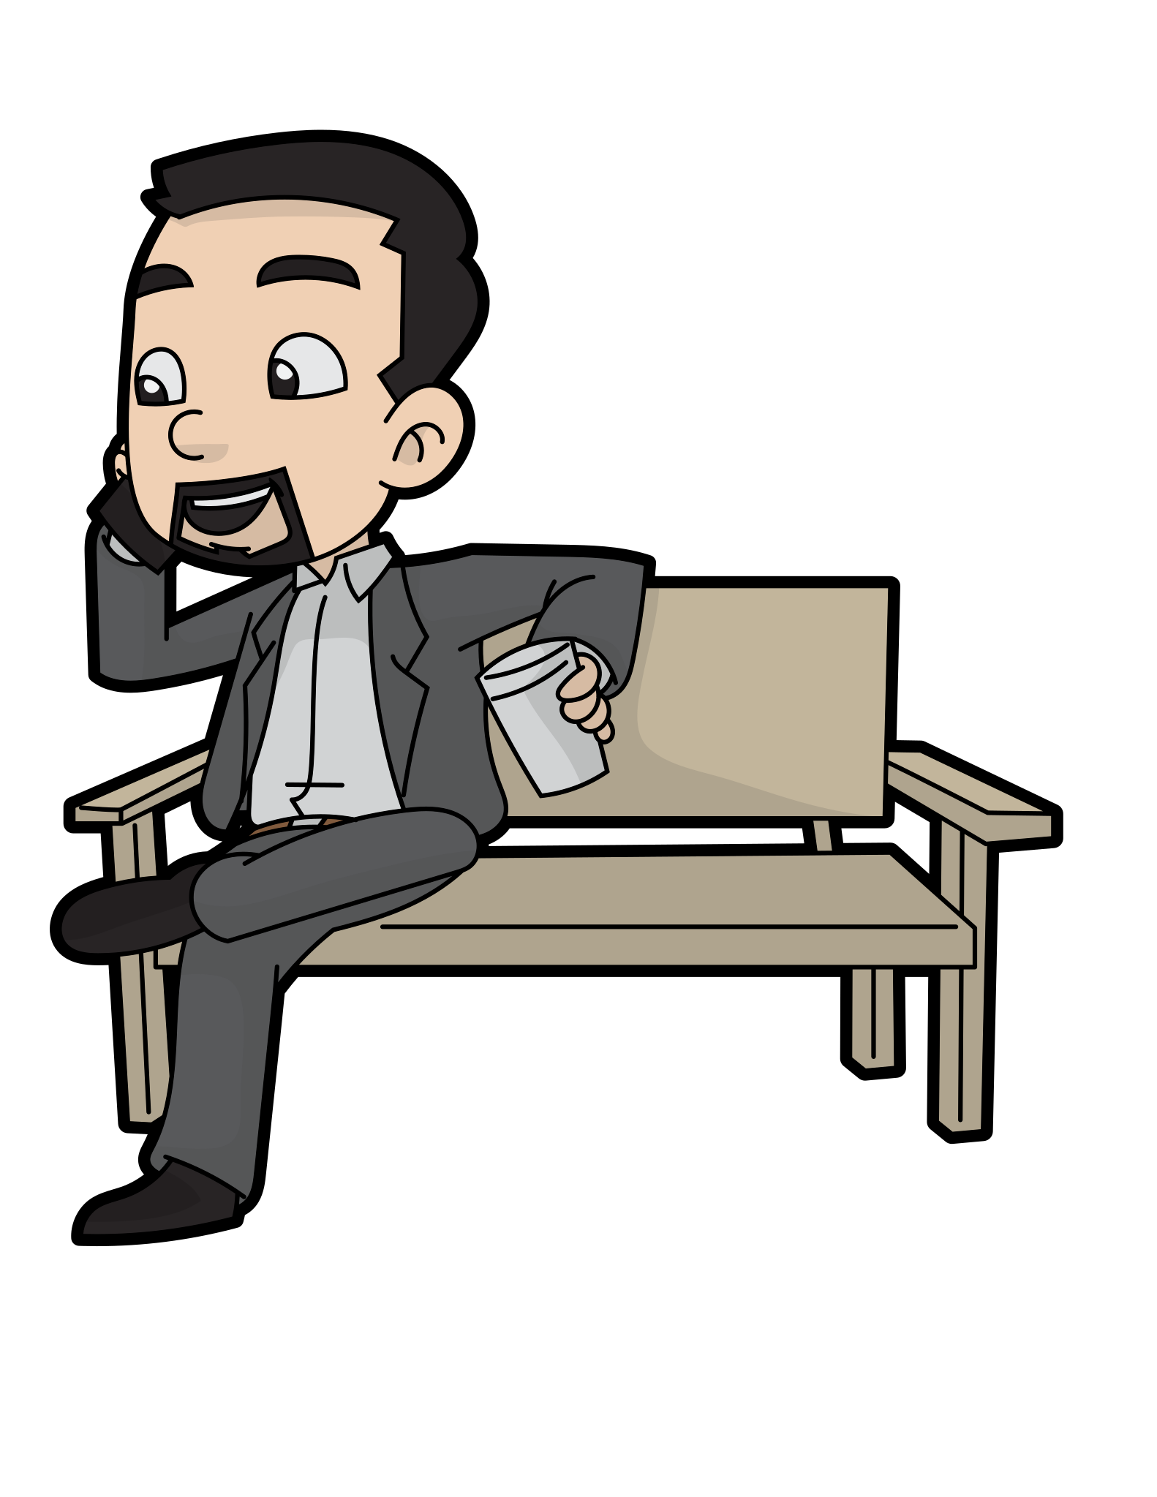
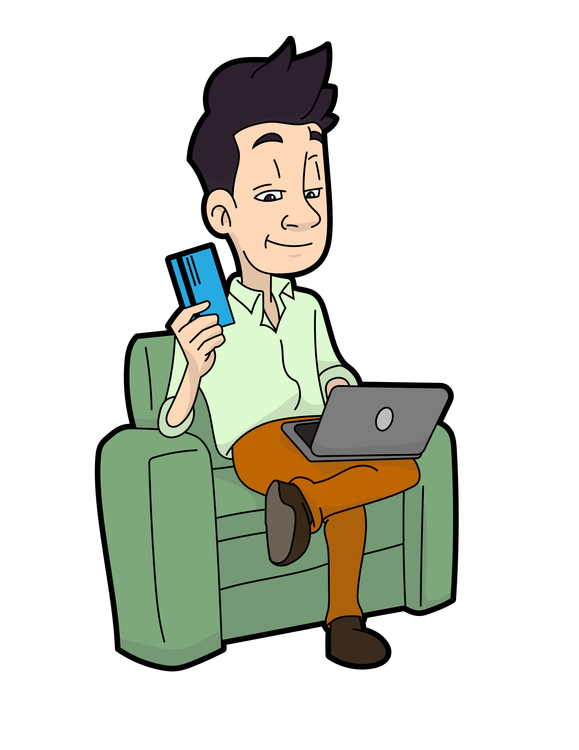
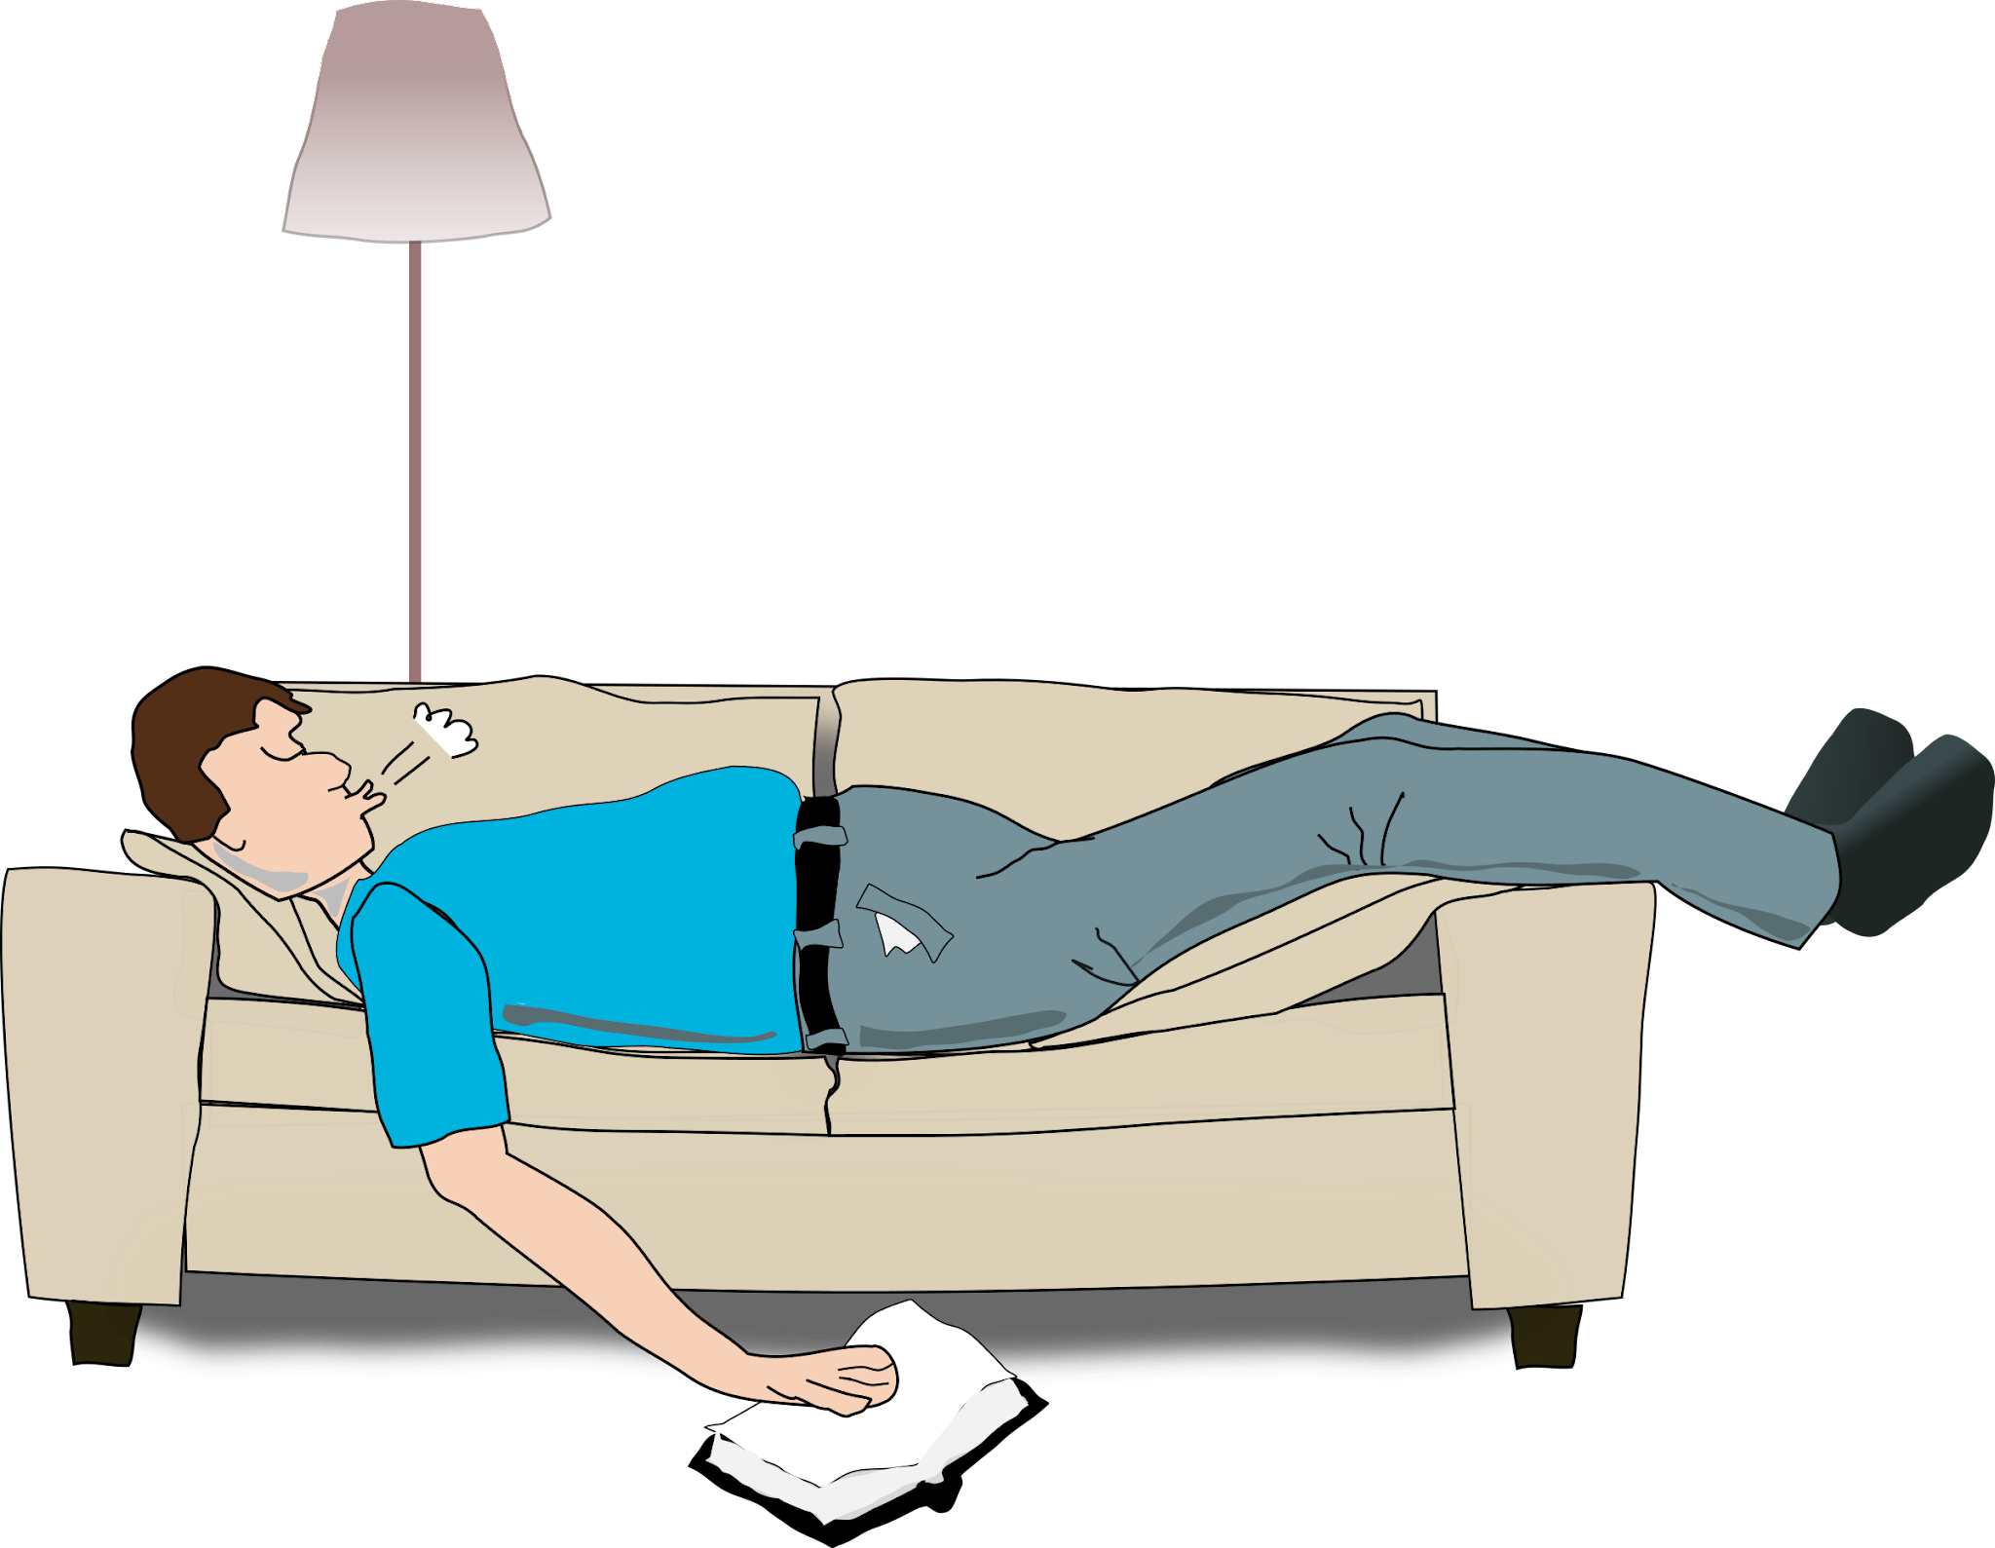
Recommendations using RFM Segmentation
Average Buyers
Send personalized product recommendations based on their past purchases
Offer loyalty rewards or discounts to encourage more frequent purchases
Hibernation
Send reactivation campaigns with special offers or discounts to bring them back
Loyal Customers
Show appreciation with exclusive offers and early access to new products
Cross-sell other categories to increase their spend
Notes:
Average Buyers = doesn’t belong to any extremes

Slide 16

Clustering the transactions
Method: K-Means Clustering
Simple but effective Machine Learning algorithm
Groups similar data points together into clusters
K-means clustering was used to segment customers based on transaction amount, hour, and category.
Transaction Amount
Time of Day
Shopping Category
Notes:
Aside from looking at the customer segmentation we also took a look at a different angle clustering the transactions
K means clustering is an unsupervised machine learning algorithm which partitions data into clusters
These clusters include data with similar spending patterns and other similar features and attributes We used this method to perform a deep dive on the transactions
To discover hidden patterns and insights not readily seen in traditional data analysis

Slide 17
Prevailing Clusters
Cluster n=100,000 | Average Spend | Item Category | Time of Day | Frequency per person
Cluster 0 n=39,775 | Low Spend | Personal Care | Evening, Afternoon | High
Cluster 1 n=59,040 | Low Spend | Home Essentials | Morning | High
Cluster 2 n=1,176 | Medium Spend | Non Essential | Evening, Morning | Low
Cluster 3 n=9 | High Spend | Travel | Afternoon, Morning | Low
*n = number of transactions
Notes:
Here is a quick overview of the clusters
So average spend consists of low, medium, and high average spend
The item categories are the mode of each cluster
They are also likely to fall under a specific time of day
And finally we can see the transaction frequency per person
We will use this to derive our recommendations on what to do per cluster
Recommendations vary depending on the priorities of the business
Our recommendations are general and focused towards achieving our objectives

Slide 18
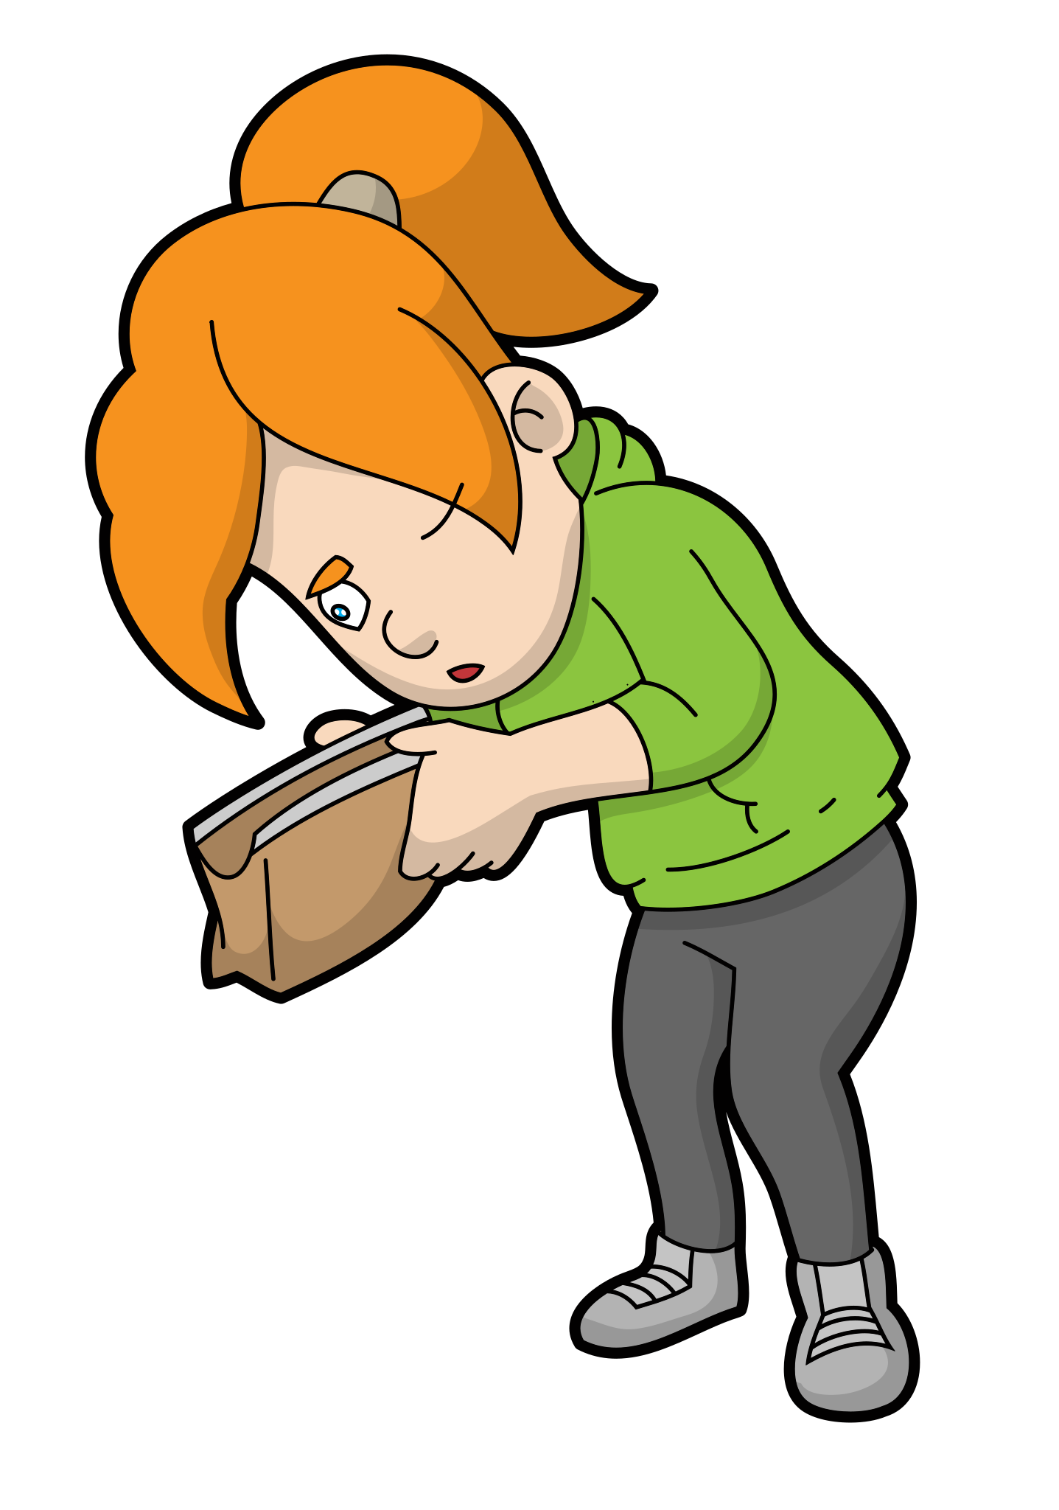

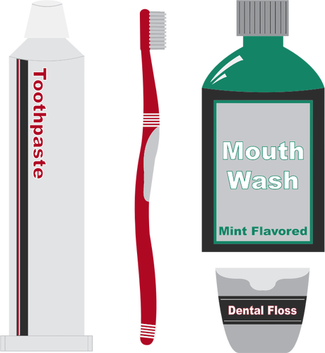
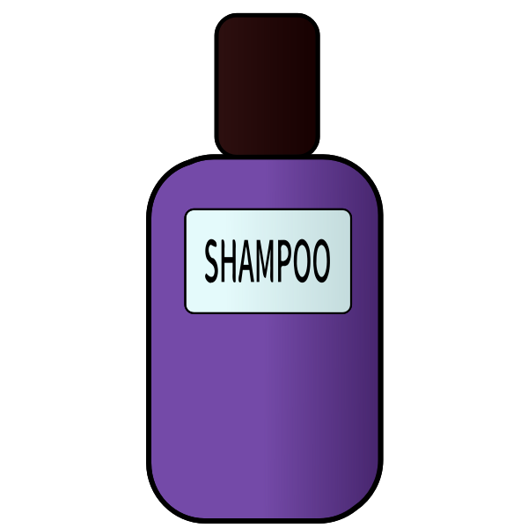

Home and Personal Care Transactions
Cluster | Average Spend | Category | Time of Day | Frequency
Cluster 0 n=39,775 | Low Spend | Personal Care | Evening, Afternoon | High
Cluster 0 Recommendations:
Bundle Deals: Create bundle deals as an effective way to encourage clients to make larger purchases especially during night transactions.
Category-Based Rewards: Create special rewards for kids and pets, home, and personal care products.
Limited-Time Offers: Create limited-time offers, such as "double cashback weekends" or "flash sales, to generate excitement and motivate clients to spend especially during night transactions.
Notes:
Cluster 0 have low spending habits but high transaction rates. These cluster primarily allocate their funds to home and personal care expenses and tend to shop during the evening and afternoon.
As for our recommendations, as they have low spending habits, we recommend bundle deals especially during evening and afternoon transactions as effective way to encourage them to make larger expenses, secondly, as these cluster spends the most on kids_pet, home and personal care products, we recommend the creation of special rewards to such products, and lastly offering of limited-time offers especially during the evening and afternoon will motivate and excite them to spend more.

Slide 19


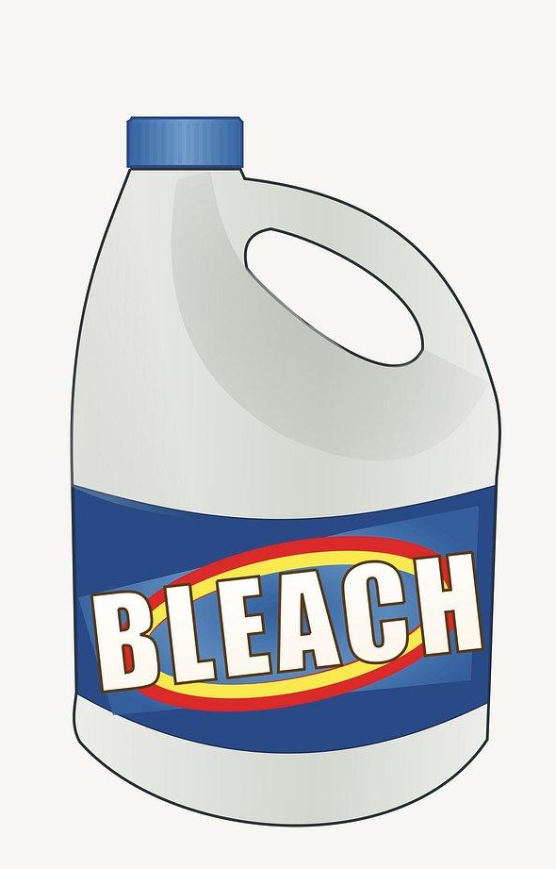

Home Essentials and Grocery Transactions
Cluster | Average Spend | Category | Time of Day | Frequency
Cluster 1 n=59,040 | Low Spend | Home Essentials | Morning | High
Cluster 1 Recommendations:
Morning deals: Offer special promotions or deals during the early morning hours to attract more customers from this cluster. Consider offering discounts on groceries or gas for their daily commute.
Personalized Recommendations: Use data analytics to provide personalized product recommendations based on their shopping habits to encourage larger transactions.
Convenience: Focus on providing convenience for these customers, such as easy online ordering and quick checkout options.
Notes:
The next Cluster consists of transactions with low spending habits but also have high transaction rates which primarily engage in home essentials and grocery transactions especially during the morning. So, to encourage larger transactions from these cluster, we recommend morning deals or offering of special promotions, discounts on groceries or gas for daily commute when they go and shop in the early morning, likewise, personalized product recommendations and easy online ordering and quick checkout options can provide them more convenience.

Slide 20

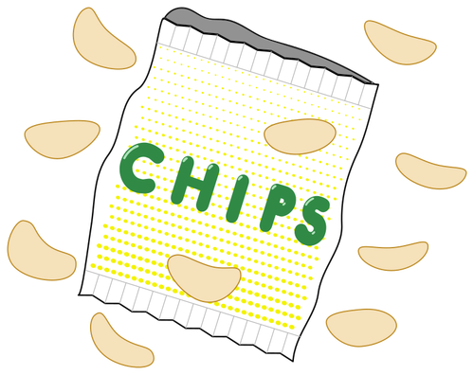

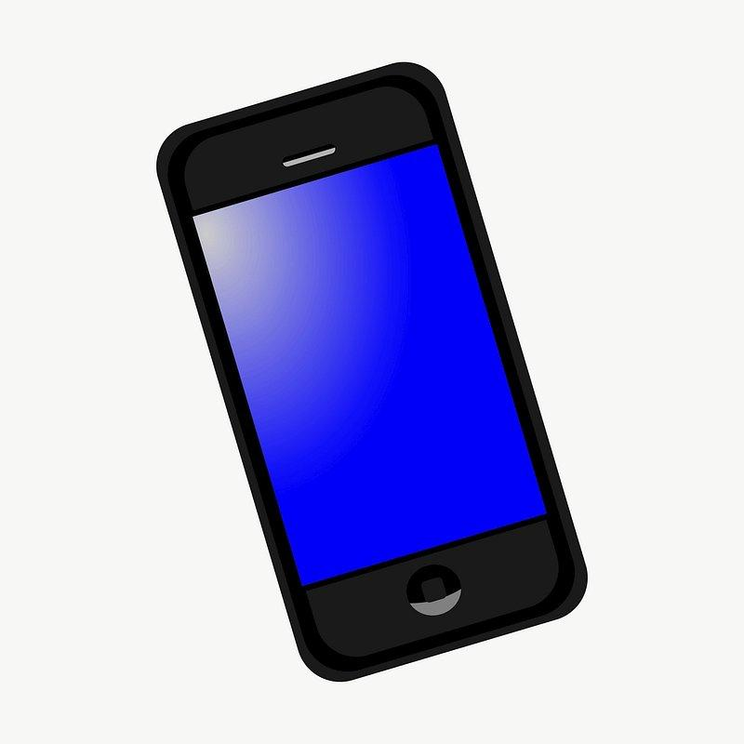

Shopping and Non-Essential Transactions
Cluster | Average Spend | Category | Time of Day | Frequency
Cluster 2 n=1,176 | Medium Spend | Non Essential | Evening, Morning | Low
Cluster 2 Recommendations:
High-End Products: Since this cluster has significantly higher average spend, consider offering high-end or luxury products that match their spending capacity and to increase spending frequency.
Exclusive Events: Organize exclusive late-night shopping events or limited-time offers for this cluster to entice them to spend more.
Notes:
So, for cluster 2 we have shopping and non-essential transactions
Under this cluster we have 1176 transactions which were seen to have medium spend under non-essential categories.
This cluster represents those people who transacted during late evening and morning hours with a low frequency.
Thus since this cluster has a significantly higher spend, we consider offering high.end luxury products that match their spending capacity and to increase spending frequency.
We can also: Organize exclusive late-night shopping events or limited-time offers for this cluster to entice them to spend more.
To increase sales and usage for a credit card among low spenders who use their card with moderate frequency, AAC can implement strategies that make the card more appealing and rewarding for this specific customer segment.

Slide 21

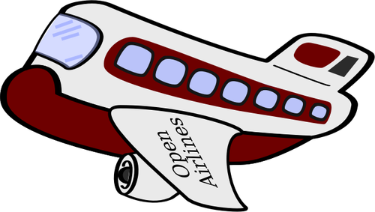
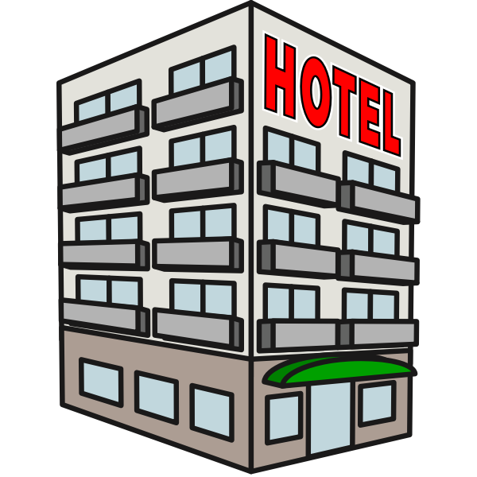
Travel and Hotel Bookings
Cluster | Average Spend | Category | Time of Day | Frequency
Cluster 3 n=9 | High Spend | Travel | Afternoon, Morning | Low
Cluster 3 Recommendations:
Travel Packages: Since this cluster is focused on travel, offer tailored travel packages, discounts on flights, hotels, or vacation packages to cater to their interest.
Exclusive Travel Benefits: Provide exclusive travel benefits or rewards programs for this cluster, such as access to airport lounges, or offer low-fare discounts/events.
Search Engine Optimization: Improve search engine optimization to increase views that would eventually lead to ticket sales.
Notes:
So for the next cluster, Cluster 3 we have Travel and hotel bookings.
Under this cluster we have 9 transactions which were seen to spend a lot under the travel category. This cluster was seen to do their transactions during the afternoon and morning with a low frequency.
Thus Since this cluster is focused on travel, offer tailored travel packages, discounts on flights, hotels, or vacation packages to cater to their interest.
We can also Provide exclusive travel benefits or rewards programs for this cluster, such as access to airport lounges, or offer low-fare discounts/events
And lastly, Improve search engine optimization to increase views that would eventually lead to ticket sales.

Slide 22
Further Research
Once more clients subscribe to AAC and more sample size of account numbers can be analyzed, revisit analysis on RFM
Widen the dataset to cover younger customers to achieve a more robust analysis
Get more data from customers from the different cities to be able to better gauge spending patterns according to location
Further drill down on each item category e.g. subdivide shopping to uncover additional insights
Increase data gathered to cover other features such as family income or other demographics such as marital status, etc. that may affect spending patterns
Include data spanning more years to improve seasonality analyses
Notes:
These are further observations of the group to improve the dataset and have more robust analyses including sample size, age groups, location data, item categories, income, marital status, and seasonality

Slide 23
Thank you!
Notes:
Arigato Gozaimasu

